Slide 1
Predictive Demand Modeling in the Logistics Industry
Presented by
S.SRIRAM

Slide 2
Objective
This project clearly addresses the importance of demand forecasting, particularly in retail, which is closely related to logistics.
It emphasizes how accurate sales forecasting can help manage inventory, staffing, and promotions, which are crucial for logistics as well.

Slide 3
Key Factors
Economic Indicators, Seasonal Variations, Technological Advancements, and Regulatory Changes:
This project involves analyzing various factors like holidays (seasonal variations) and economic conditions (oil prices), which are analogous to the factors mentioned for logistics. This could be expanded to include broader economic indicators or industry-specific trends

Slide 4
Data Collection and Sources
This project uses historical sales data, economic indicators (oil prices), and potentially seasonal information. The data sources in this project include Kaggle datasets, which can be aligned with industry reports and company records in a broader context.

Slide 5
Data Preprocessing
We have worked on handling missing values, forward-filling oil prices, and creating features from the date column corresponds directly with the data preprocessing steps.

Slide 6
Exploratory Data Analysis
Visualising Trends and Correlation Analysis
You conducted EDA by analyzing sales distribution, trends over time, and correlation between different features, which aligns with this slide’s focus on visualizing data trends and deriving key insights.

Slide 7
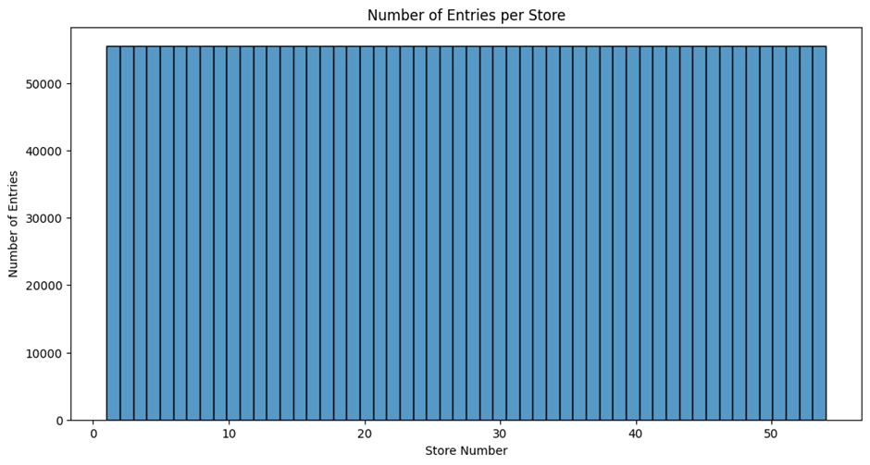
Store-wise distribution of entries

Slide 8
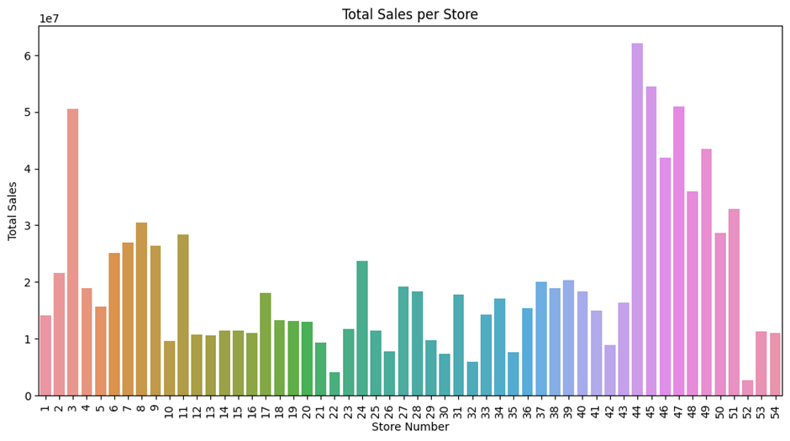
Total Sales per Store

Slide 9
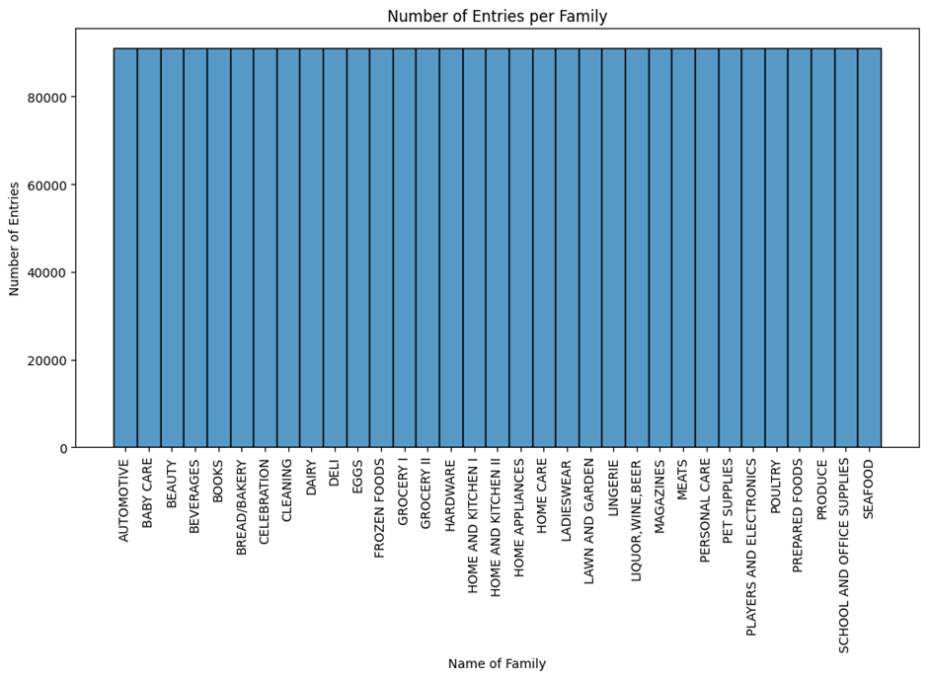
Number of entries in each family

Slide 10
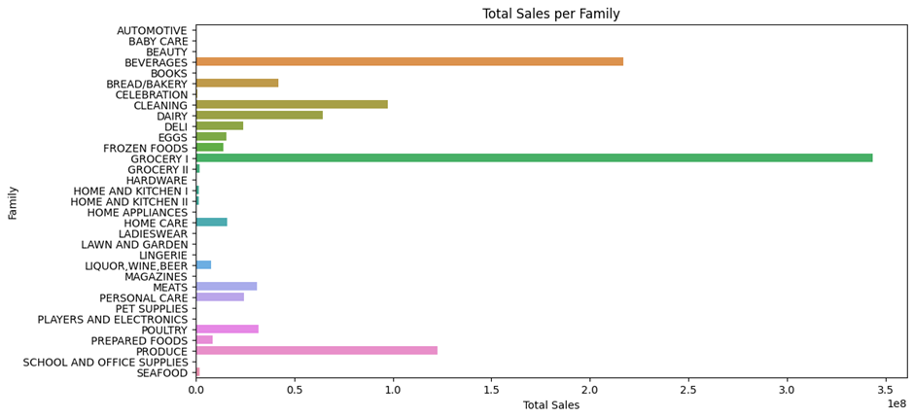
Total sales of each family

Slide 11
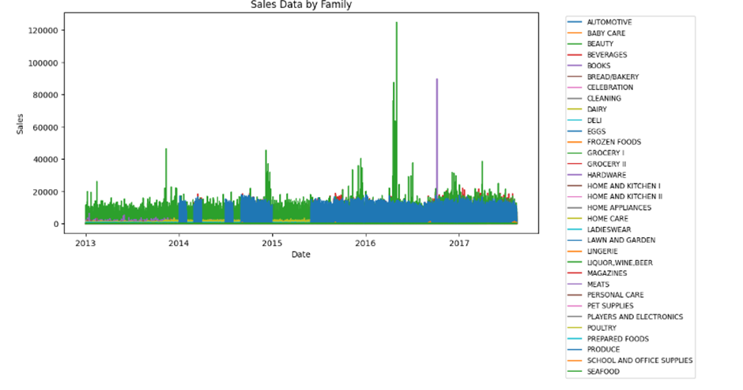
Total Sales across years

Slide 12
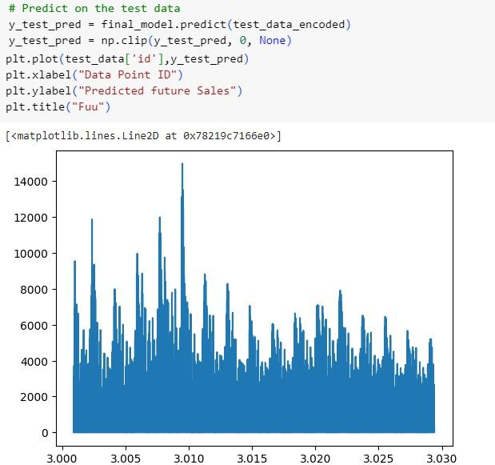
Predicted Results

Slide 13
Model Selection
This project focuses on using XGBoost, a powerful machine learning , for time series forecasting. This aligns with the machine learning models mentioned in the presentation. You could expand your discussion to include why XGBoost was chosen over other models like ARIMA or LSTM

Slide 14
Model Development
We applied Bayesian optimization for hyperparameter tuning and used a time-based validation approach, which fits well with the model development slide. We evaluated the model using RMSE, which aligns with the evaluation metrics suggested in the presentation.

Slide 15
Prediction and Forecasting
This project involves making predictions and visualizing forecasted sales, which is in sync. You can further detail your scenario analysis or any stress testing you performed on the model

Slide 16
Model Deployment
While this project may not explicitly discuss deployment, we can extend our analysis to discuss how the model could be integrated into a retail business’s operations, similar to the logistics industry. Consider discussing potential automation and monitoring strategies.

Slide 17
Challenges and Limitations
This project touches on challenges like handling missing data and the potential impact of external factors (e.g., economic conditions represented by oil prices). This can be expanded to discuss the broader challenges of model accuracy, overfitting and data quality

Slide 18
Conclusion
Summary and Future Directions: This project’s conclusion could summarize the key findings, such as the importance of feature engineering and the effectiveness of XGBoost for time series forecasting. We can suggest future improvements like incorporating additional external factors or testing with different model architectures.

